Slide 1

2025 ACES Challenge

Slide 2


Why a case competition?
Complex steps are needed top form digestible insights and implementable action plan when facing challenges associated with the changing energy landscape
Provide interns with an opportunity for cross-industry collaboration from industry participants
Receive insights from those outside of the electric utility industry on relevant and meaningful topics

Slide 3

Case competition presentation times:
Case Competition Presentations
20 minutes + 10 minutes Q/A
Groups TBD

Slide 4
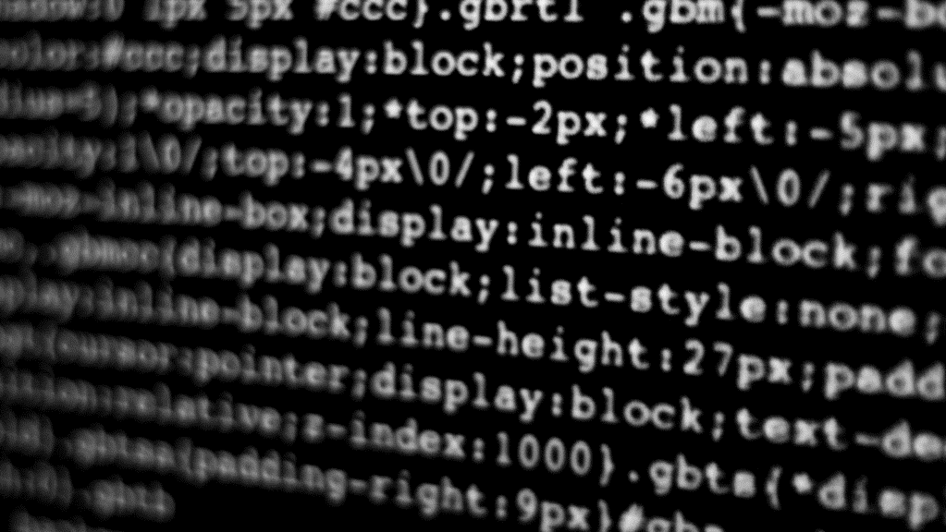
Challenge topic:
Securing the future of load-driven energy risk

Slide 5
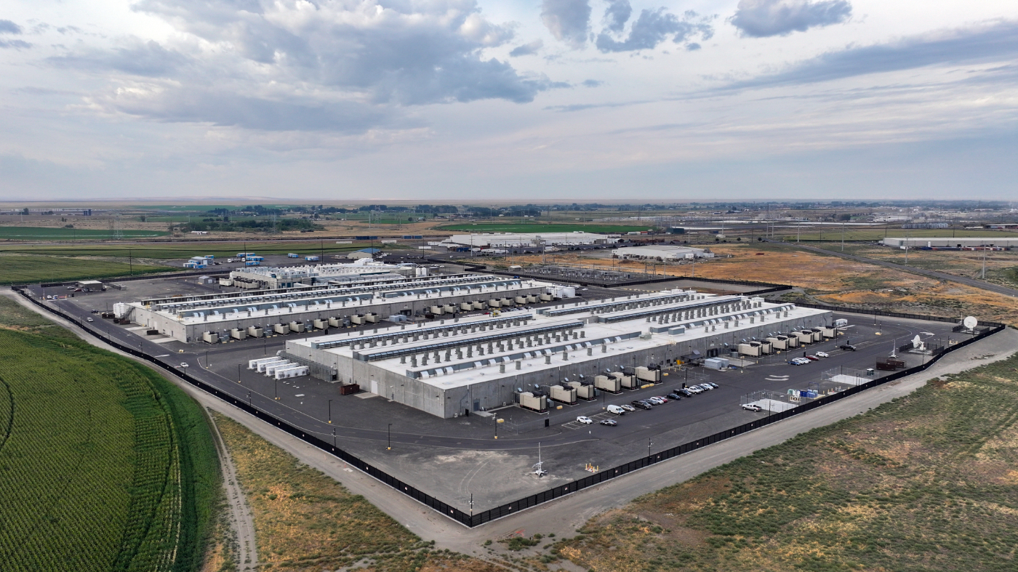
WHAT IS A Large load?
Large Loads (or large electrical loads, large data-driven loads) can be referred to facilities with high electrical demand
Types of facilities:
Commercial data centers
Crypto-mining operations
Industrial facilities

Slide 6
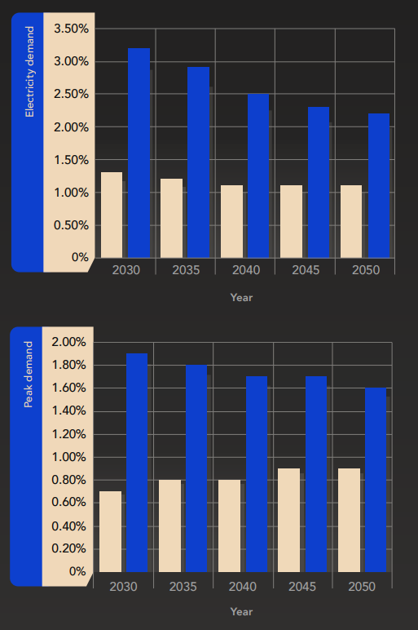
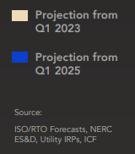
Load estimations and projections
Year-Over-Year estimations show that demands will increase at record pace due to the rate of high load infrastructure being put in.
Expectation of grid stability
Low regard to security

Slide 7
THE Challenge:
Mitigating cyber risks for high-load utilities

Slide 8
Challenge questions for analysis
What risks can be identified and likelihood of being exploited?
    Keep in mind of the types of data that can be introduced, the vulnerabilities that may exist, and what kind of technologies are needed to keep the lights on.
Would there be any detection opportunities for utilities to leverage when on-boarding large loads?
    Ways to identify mismatched data or anomalous machine behavior.

Slide 9
considerations for analysis
Response Plan: Define how you will identify and respond to the threats of grid operations and the vectors of which these attacks can come through.
Technological Framework: Outline the risks associated to NIST Cybersecurity Framework, with various tools and technologies including data analytics, machine learning, artificial intelligence, and IoT tools.
Regulatory Compliance: Ensure your controls would align with NERC CIP standards.
Stakeholder Impact: Consider the benefits and impacts on all stakeholders, including grid operators, security analysts, and end consumers.

Slide 10

QUESTIONS

